Slide 1
Auburn Hackathon 2017
MARS: Through Rovers’ Eyes
Team: Buckeyes, Tigers, & Bulldogs, oh my!
Team members:
Victoria Platt & Makenzie Neeley

Slide 2
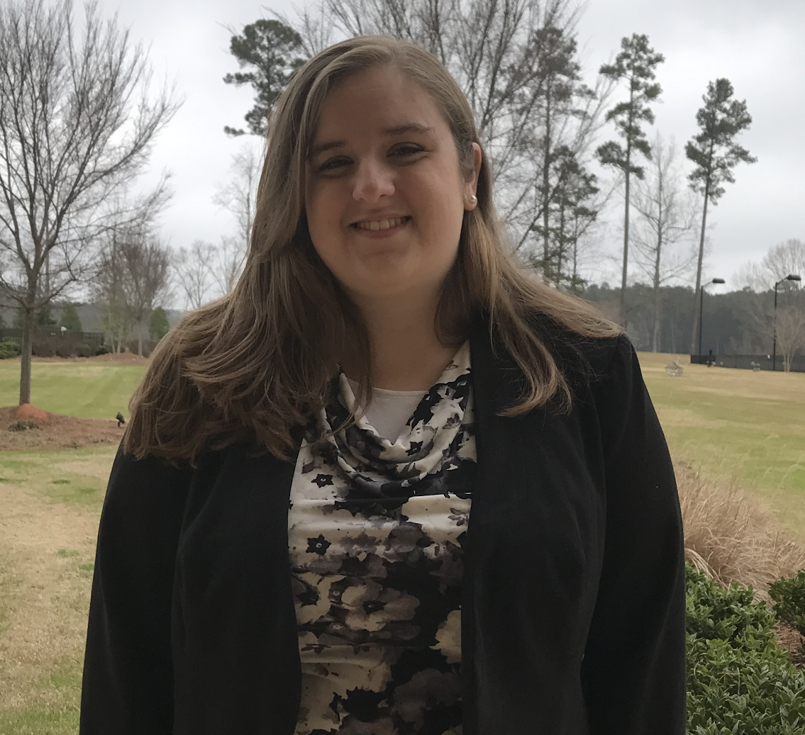
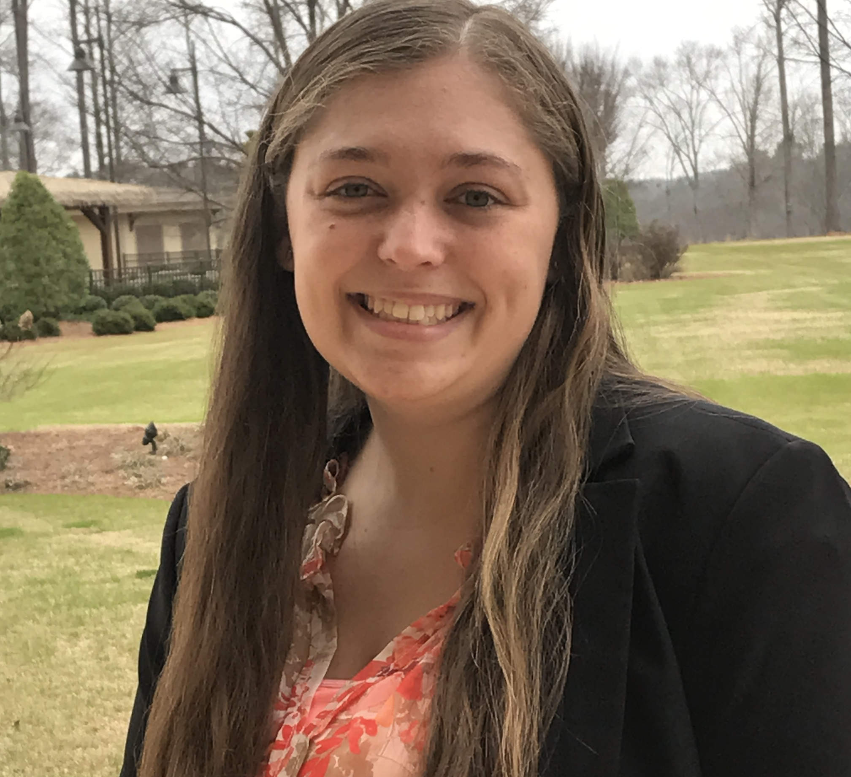
About the Team
Makenzie Neeley
Undergraduate degree: Auburn University 2015 Industrial & Systems Engineering (BISE)
Minor: Spanish
Degrees in progress: Auburn University 2017 Industrial & Systems Engineering (MISE) & Business Administration (MBA)
Victoria Platt
Undergraduate degrees: The Ohio State University 2014 Industrial & Systems Engineering (BSISE) & History (BA)
Minor: Business
Degrees in progress: Auburn University 2018 Industrial & Systems Engineering (MISE) & Business Administration (MBA)

Slide 3
Problem Statement
Create a webpage or app using any programming languages & technologies within their acceptable use terms
Pull from NASA photograph database of Mars rovers’ photos
Allow user to choose a rover, Martian or Earth day, and camera
Show user photographs from selected criteria
Pictures are uploaded on a few sol lag to NASA’s site, so today’s images aren’t available

Slide 4
Requirements and Constraints
Requirements
User input: Rover & date & camera
Back end: find images meeting user input criteria in NASA databases
System output: corresponding picture or notification that no pictures exist for selection
Constraints
Not every date & Rover combination has a picture
Must be able to accept Sol or Earth day
Sol days correspond to different Earth days for each rover based on its arrival date
Limit of 1000 queries per hour on NASA api without an api key

Slide 5
Decisions
Website over app to be accessible to more users
Website features work best in Google Chrome
Accept NASA 1000 queries/hour limit to eliminate need for an api key
Using sol days based on rover’s landing (not sol date based on start of April 11, 1955) to correspond to NASA’s dates
If an Earth day and a sol day are selected, Earth day is used
Set photographs per query & page limit to speed loading time
Using getJSON() to show selected images
Include an error message to give user feedback if no picture exists for selection
Curiosity’s Happy Birthday video with message that no photos match selected criteria

Slide 6
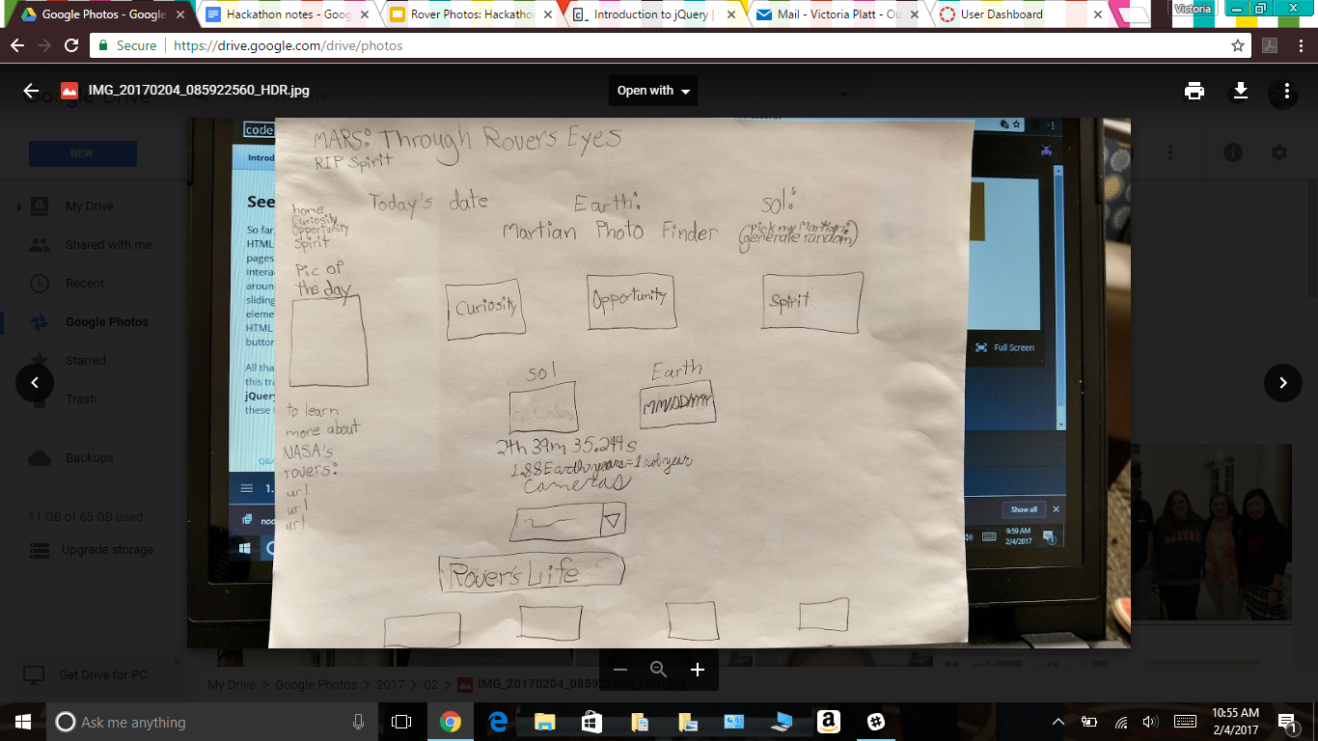
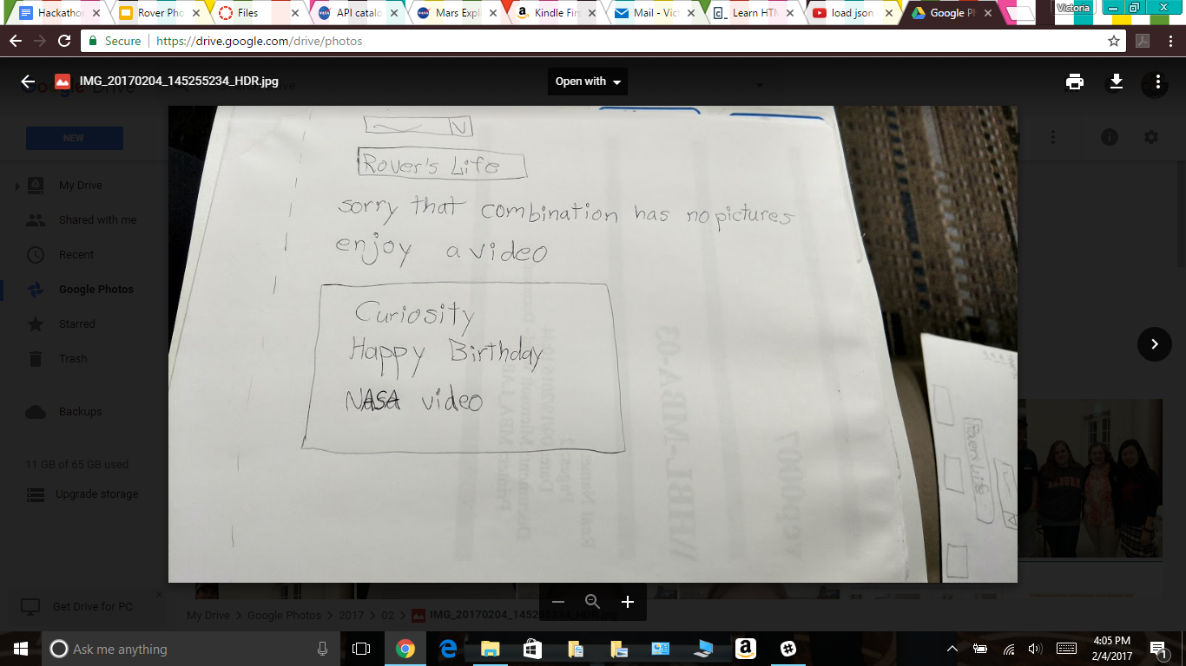
Concept Design
Home Page: 1st Mock Up
Error Page: 1st Mock Up

Slide 7
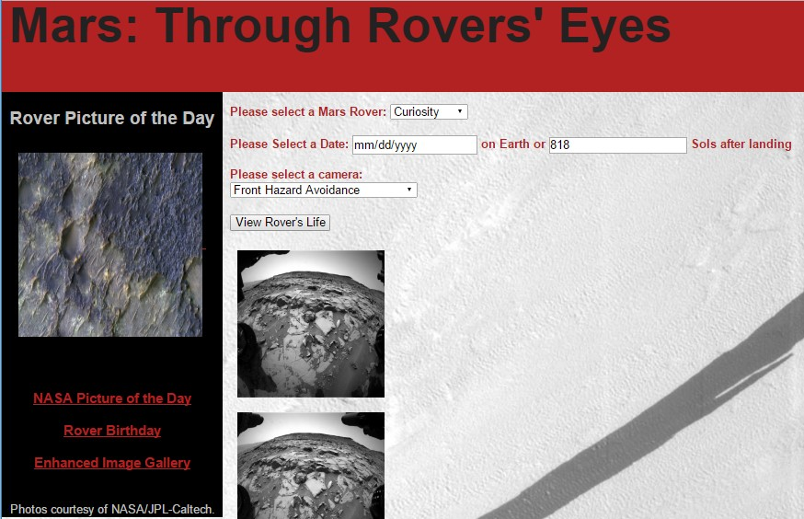
Proposed Solution
Web based solution coded in HTML5, Javascript ,and JQuery in Aptana Studio 3
Simple, uncluttered design
Working prototype:

Slide 8
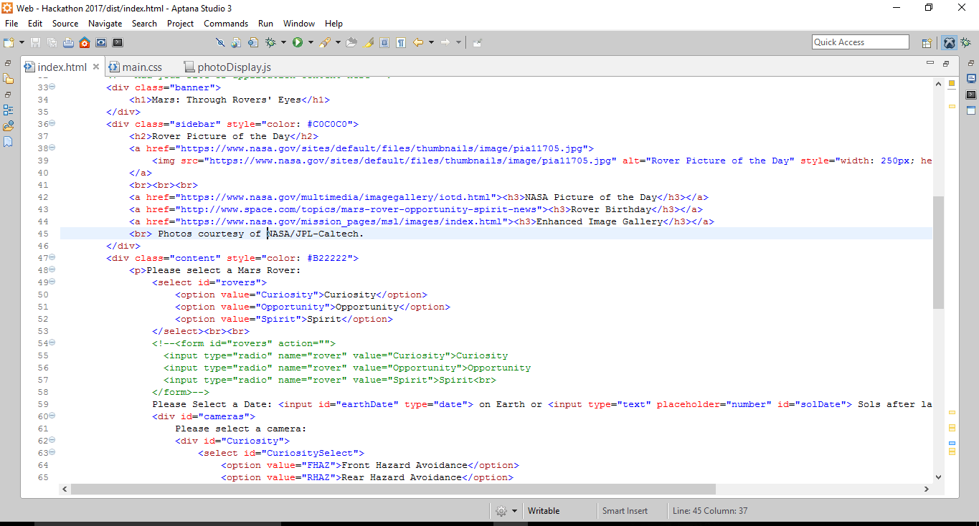
Code and Challenges
Calling picture of the day from database
Clearing pictures before each new query
Writing 152 lines of code

Slide 9
Site Wishlist/Next Features
Mars&You: Impose your picture over the rover’s picture
RoverJourney: See a rover’s day as a time ordered slideshow of pictures from the front camera
Pictures of the rovers as buttons to select the rover
Display current sol date for each Rover on sidebar

Slide 10
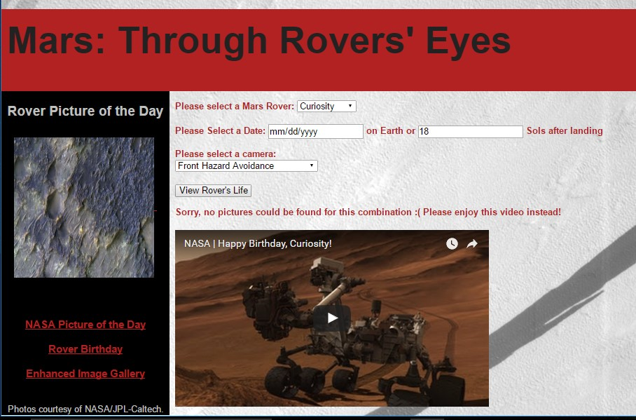
Buckeyes, Tigers, & Bulldogs, oh my! Summary
Web site solution coded in html5, Javascript, and Jquery in Aptana Studio 3
Background & Pic of the Day are cleaned images taken by Curiosity
Error message shows NASA Youtube video
Team members: Makenzie Neeley & Victoria Platt

Slide 11
Resources Utilized
https://api.nasa.gov/
Rover Photos, Thanks NASA
https://www.nasa.gov/mission_pages/mars/images/index.htm
https://www.youtube.com/watch?v=uxVVgBAosqg

